Slide 1
Spending on Opioids
Next we looked at how the amount spent on opioids related to overdose deaths, both in strict numbers and as compared to non-opioid prescription spending.
To normalize the available data, we compared annual averages per capita across the counties of Tennessee.

Slide 2
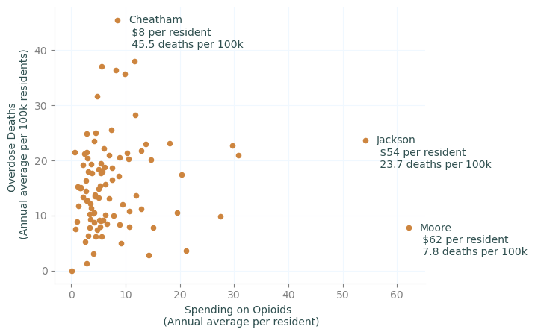
Death rates vary within narrow band of spending
Most Tennessee counties spend, on average, less than $10 per resident on opioid prescriptions each year, but average annual overdose death rates per hundred thousand range from zero to over 40.

Slide 3
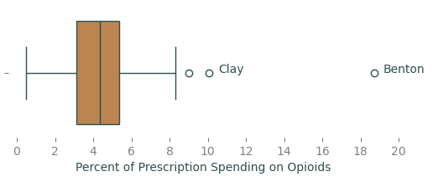
Percent of prescription spending on opioids
For over 75% of Tennessee counties, less than 6% of prescription drug costs go to opioids. But for Clay, Coffee, and Montgomery counties, that number is over 8%, and in Benton 18.7% of prescription costs are for opioids.

Slide 4
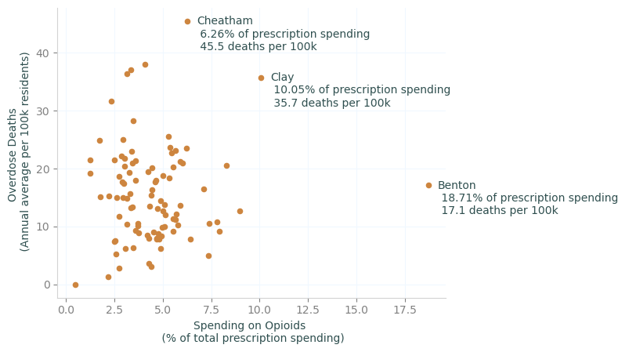
Increased proportion of opioid spending not related to death rate
The percentage of prescription costs spent on opioids has no strong correlation with the overdose death rate across Tennessee counties, with a correlation coefficient of 0.054.

Slide 5
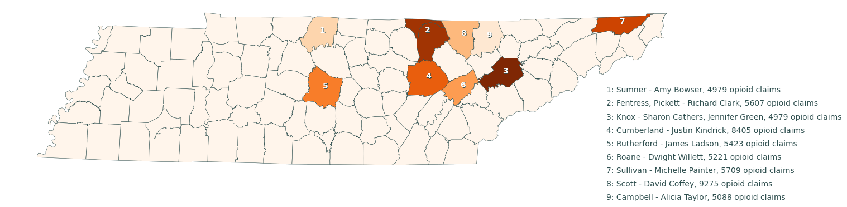
Top Prescribers of Opioids
The top ten prescribers of opioids, by number of claims, are scattered in the northeastern part of the state, but are particularly concentrated in the counties north of Knoxville.

Slide 6
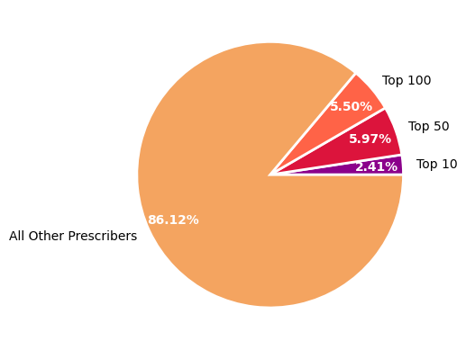
Top Prescribers of Opioids
The top hundred prescribers by number of opioid claims account for 13.9% of all opioid claims in Tennessee, despite accounting for only 1% of physicians who prescribed opioids from 2013 – 2017.

